Slide 1

Delete this slide before use
Template for CISO GenAI Presentation to Board or AI Committee

Slide 2


Using this presentation template
Delete this slide before use
This presentation template is designed to help CISOs organize board-level reporting on AI usage, risk, and governance. It works for board of directors or AI committee updates.
Directions
The core presentation is composed of 6 primary slides and supporting speaker notes
Customize these slides with your organization’s specific AI use cases, risks, and policies.
Replace the placeholder visuals (marked with [ placeholder ]) with your own data or metrics.
Review the speaker notes under each slide for guidance on what to emphasize.
Use appendix slides, if provided, to go deeper into metrics, frameworks, or incident detail.
Note: The usage, risk, and control metrics shown in this deck can be automated with browser-level visibility platforms like Keep Aware. This template is vendor-neutral, but tools like Keep Aware can help CISOs answer these exact board questions with real data. You can request a demo or start your free trial here.

Slide 3
Communicating GenAI adoption and risk to your Organization
Delete this slide before use
Remember: you are speaking about AI and security to leaders who may not have deep technical expertise.
Focus on where AI is being used, what risks it creates for sensitive data and compliance, and how governance and controls reduce those risks.
Translate technical risks into business impact: data leakage, regulatory exposure, and trust in company operations.
Keep the story simple and compelling. Clarity inspires confidence more than detail. But ultimately, you must back the story with data. The board will want measurable answers: Which AI tools are in use? How much sensitive data has been exposed or prevented from leaving? Are policies effective? Without data, risk discussions remain abstract. With it, you can quantify impact, demonstrate control, and earn trust.

Slide 4
GenAI Adoption, Risk and Governance at
[ Your Company Name ]
[ MONTH ], [YYYY]
[ Your Logo ]
Notes:
Modify this slide to add your organization’s name and logo.
This slide is written for a monthly update, but can be adjusted to reflect a quarterly or annual outlook.

Slide 5
Last update on GenAI
GenAI Adoption
Agenda
Risk Landscape
Governance and Controls
GenAI Adoption, Risk, and Governance
Notes:
These slides serve as a transition to the next topic. Adjust as needed.

Slide 6
Summary of the last update
Readiness for onboarding new tools, Risk of current AI in use
New controls in place, suggested controls
Adoption
GenAI Adoption, Risk, and Governance
Notes:
Open with context for the organization: “Since the last update, GenAI has shifted from a novelty to a productivity staple.”
Explain what the organization’s last stance on GenAI in the workplace was. What did adoption look like over the organization?
Leaving the last meeting, were any newer tools discussed for formal onboarding? What controls were proposed?
Explain that the regulatory environment is evolving. Are there any major updates since the last conversation? EU AI Act, SEC cybersecurity disclosures, and sectoral compliance (HIPAA, FINRA, GDPR) are all touching GenAI indirectly.
Position this slide as status-setting: the audience should leave with the sense that GenAI is no longer optional or “in pilot”, it’s embedded, and oversight is overdue.

Slide 7
Last update on GenAI
GenAI Adoption
Agenda
Risk Landscape
Governance and Controls
GenAI Adoption, Risk, and Governance
Notes:
These slides serve as a transition to the next topic. Adjust as needed.

Slide 8
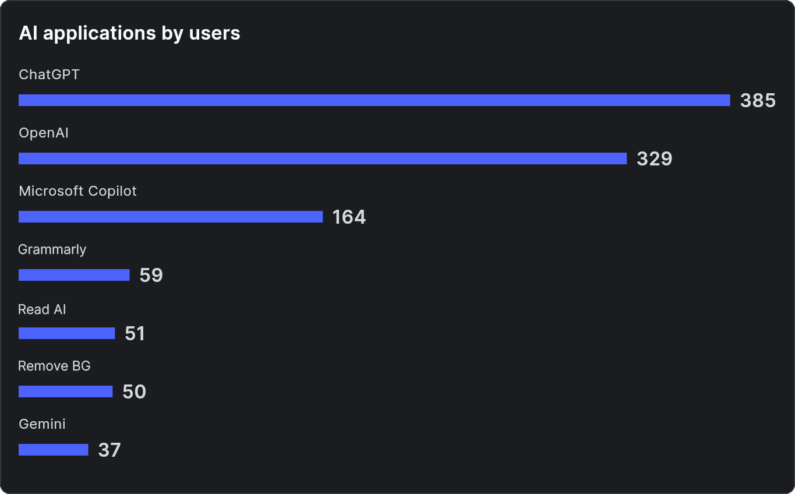

GenAI Adoption Overview
“How widely is AI being used, and in what ways?”
Sanctioned tools
17 tools
Official AI tools sanctioned (Copilot, ChatGPT, Salesforce Einstein, Harvey, etc)
Employee driven activity
121K activities
Uploads, prompts, downloads and sessions with various platforms
[ placeholder ]
Employees
2K employees
Employees using AI tools this month
AI applications by total usage. Identify departments or groups utilize these tools.
GenAI Adoption, Risk, and Governance
Notes:
This slide shows how widely AI is being used, and in what ways. We’re looking at sanctioned tools, employee-driven activity, and adoption footprint.
Sanctioned tools:
Highlight that your organization has officially approved a broad set of GenAI platforms (Copilot, ChatGPT, Salesforce Einstein, Harvey, etc.).
Note that sanctioned doesn’t always mean controlled employees may still use these in risky ways (e.g., pasting sensitive data).
Employee-driven activity
Explain this metric as the scale of interaction: prompts, uploads, downloads, and sessions across platforms.
Stress that this shows frequency and intensity, not just headcount, adoption is deepening into workflows.
Employees:
Point out whether this is a significant percentage of the workforce.
Use this to show that AI adoption isn’t confined to a small pilot group; it’s mainstream.
AI applications by users (right-hand chart):
Walk through the top tools (ChatGPT, OpenAI API, Microsoft Copilot).
Emphasize that usage patterns vary by role or department: e.g., Copilot more for engineering/productivity, ChatGPT for knowledge workers, Grammarly for communication.
Encourage the committee to think in terms of departmental adoption maps (who is using what, and why).
Wrap with interpretation:
Stress that adoption is broad, but oversight and governance still lag.
Position this as a foundation for discussing trends, risks, and governance.

Slide 9
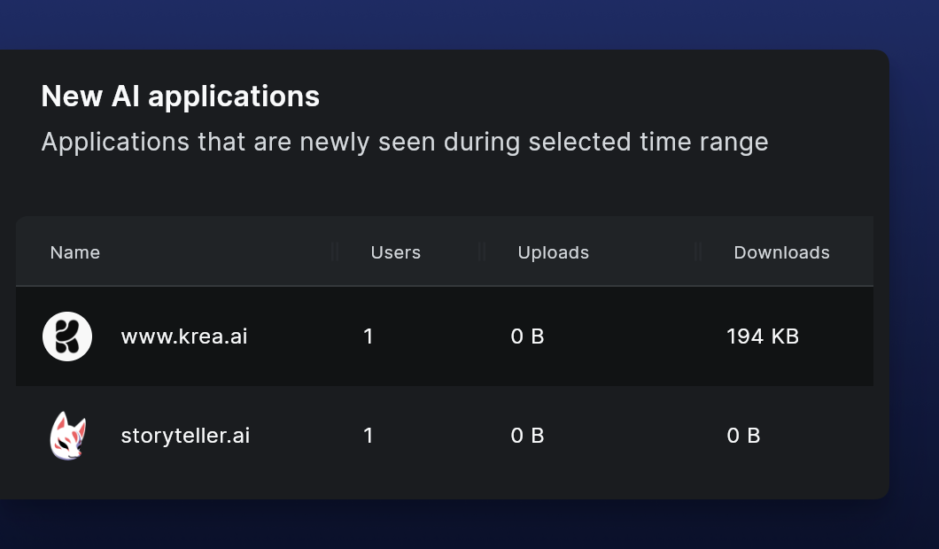
GenAI Adoption Trends
“How fast is adoption growing, and where is it outside of our control?”
New AI tools adopted
11
Any new tools been reviewed or sanctioned by the organization
Shadow AI identified
18 tools, apps
Include forms of AI such as web applications, native applications, browsers, and browser extensions
[ placeholder ]
[ placeholder ] Where we are seeing new tools be adopted, what seem to be the use cases. Identify where there might already be overlap.
GenAI Adoption, Risk, and Governance
Notes:
This slide answers: How fast is adoption growing, and where is it outside of our control?”
New AI tools adopted (11):
Stress that sanctioned adoption is not static, the list of officially approved tools keeps growing.
Any updates to the review process: Have these been reviewed for data handling, privacy, and compliance?
Note that sanctioning is often reactive, security reviews may lag behind employee demand. Consider how the organization puts guardrails on new adoption:
Is the policy to completely block until review?
Or, are there more sensitive guardrails on unapproved applications
Shadow AI identified (18 tools, apps):
Explain that “Shadow AI” represents unsanctioned tools, often web apps, extensions, or niche services (like krea.ai or storyteller.ai in the example).
Highlight the governance risk: security teams usually don’t even know these tools are in use until telemetry or incident discovery surfaces them.
Stress the compliance angle, unsanctioned tools may store or process sensitive data in ways that violate regulations.
Example data (bottom left):
Use the krea.ai and storyteller.ai examples to show how small-scale, isolated usage can quietly bypass IT review.
Make the point: Even one employee upload into the wrong AI service can equal a breach event.
Placeholders (bottom right):
Use this space to discuss observed use case clusters (e.g., design tools, writing aids, coding copilots).
Encourage mapping where overlap occurs, multiple tools serving the same use case can mean fragmented risk and wasted investment.
Wrap with interpretation:
Reinforce that the trend is exponential: sanctioned adoption is increasing, but shadow adoption is growing even faster.
Position this as a call for governance frameworks and controls at the browser layer, since that’s where both sanctioned and shadow AI activity actually occurs.

Slide 10
Last update on GenAI
GenAI Adoption
Agenda
Risk Landscape
Governance and Controls
GenAI Adoption, Risk, and Governance
Notes:
These slides serve as a transition to the next topic. Adjust as needed.

Slide 11
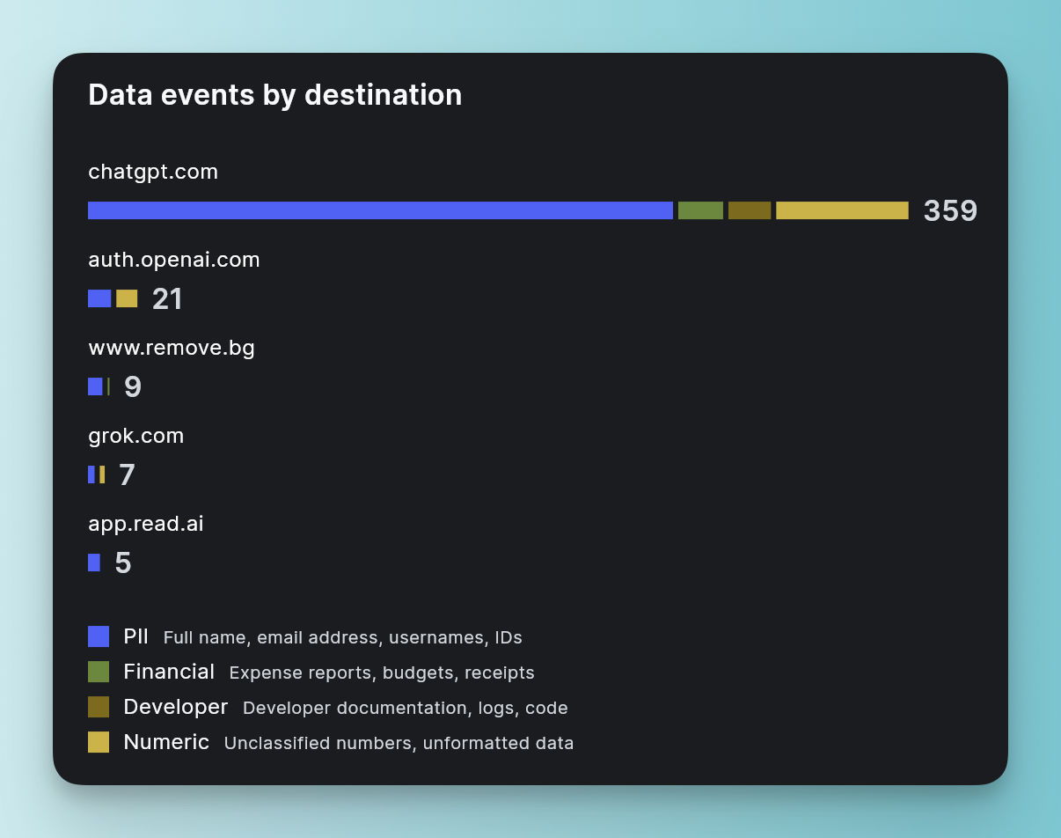
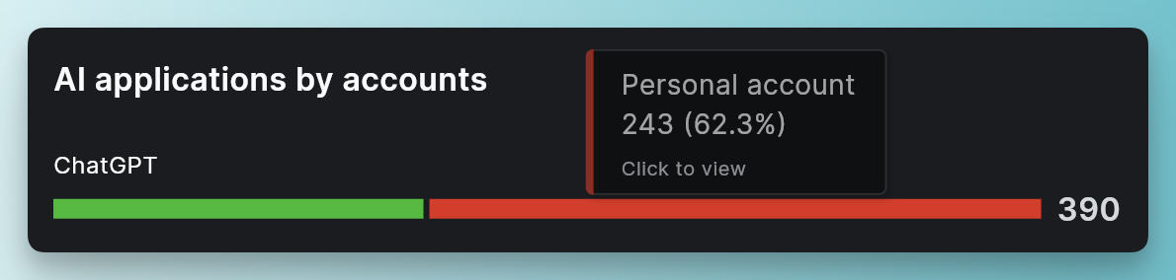
AI-Driven Risks to the Organization
“What business-sensitive behaviors make GenAI risky for us?”
Sensitive business data is the main risk vector (customer PII, source code, financials).
[ placeholder ] Highlight the data type most important to the business. Regulatory exposure: GDPR, HIPAA, PCI compliance gaps.
Behaviors to identify
Data leakage: sensitive data in prompts, uploads, clipboard actions.
Account switching: mixing corporate/personal in Gmail, Drive, ChatGPT.
Unmonitored extensions/AI plugins: over-privileged or malicious.
[ placeholder ]
[ placeholder ]
GenAI Adoption, Risk, and Governance
Notes:
This slide is about the types of risks that matter most at the business level.
Emphasize that the concern isn’t just “AI is risky,” but rather how employees interact with AI tools and what kinds of data are being shared.
Highlight that the most sensitive categories: customer information, source code, financial data, or strategy documents are the ones that could cause real damage if exposed.
Point out that using AI doesn’t create entirely new risks, but it accelerates existing ones. Employees can now move large amounts of sensitive information into external systems in seconds.
Stress that every AI prompt is essentially a data transfer outside the company’s control. That means existing security layers, email filters, endpoint tools, firewalls, often don’t see it.
Close by reinforcing: The core issue is not the AI technology itself, but the behaviors around how employees handle business-sensitive data when using AI tools.

Slide 12
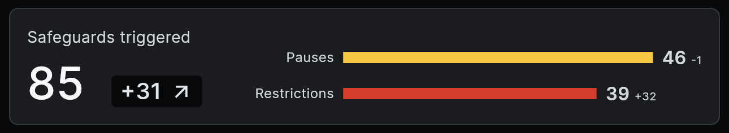
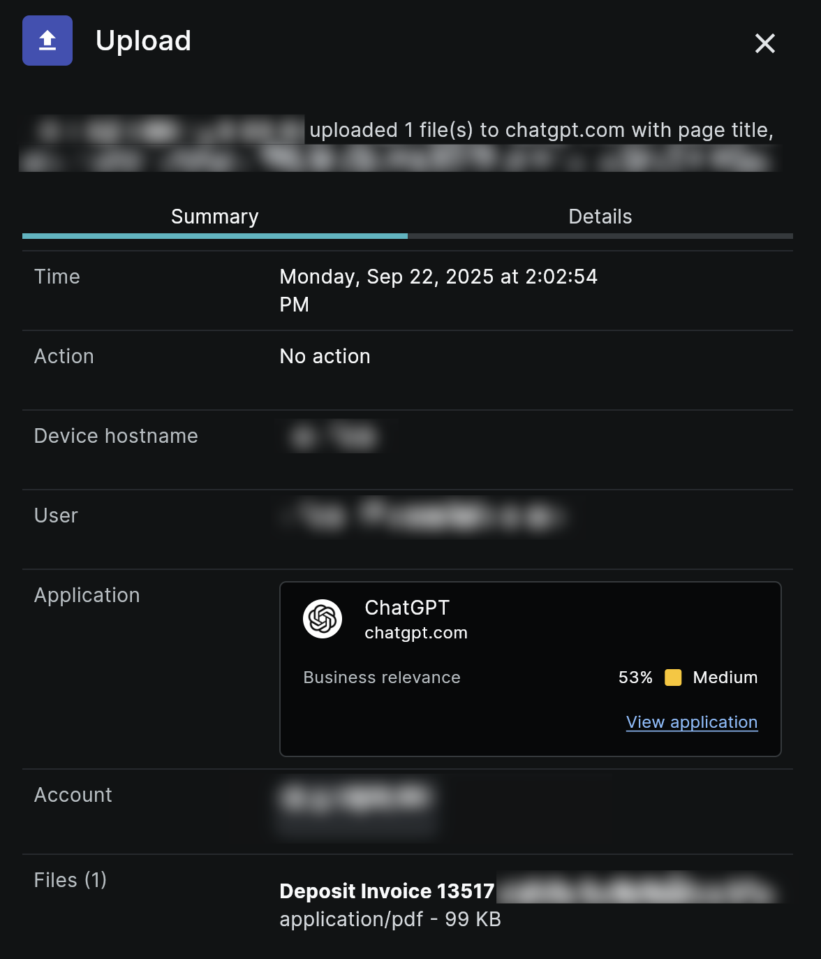

Risk exposure and Incidents
“Where is sensitive data actually going, and what incidents show this risk?”
Safeguards taken against AI violations / unsanctioned AI
Most popular unsanctioned tools
[ placeholder 1 ]: 32 employees, 74 uploads
[ placeholder 2 ]: 16 employees
[ placeholder 3 ]: 2 employees
Sanctioned alternatives (Copilot, ChatGPT, Salesforce Einstein, Harvey, etc)
[ placeholder ]
Financial leak incident
GenAI Adoption, Risk, and Governance
Notes:
Begin by pointing to the safeguards number: How many interventions were triggered. Explain that these represent moments where controls paused or restricted activity to stop sensitive data from leaving through AI tools. This shows both the scale of attempted incidents and the effectiveness of guardrails.
Break down the difference between pauses and restrictions: pauses are warnings or temporary halts where users could reconsider, restrictions are enforced blocks that prevented data movement.
Transition to the unsanctioned tools list: highlight that even with sanctioned AI platforms available, employees are still experimenting with other tools outside company approval. This reflects curiosity and productivity pressures, but it also introduces unmanaged risk.
Stress that shadow AI adoption often overlaps sanctioned use cases, meaning employees may not even realize they are creating unnecessary risk by using an alternative tool.
Use the financial leak incident example (right side) as the narrative anchor: an employee uploaded a financial invoice into ChatGPT. Even though the business relevance was marked medium, the document type is highly sensitive.
Explain the lesson: it only takes one upload to create compliance and reputational exposure. Even small or seemingly harmless actions, like uploading an invoice, can trigger regulatory, legal, or contractual issues.
Wrap with the takeaway: safeguards are working, but the underlying trend shows that employees will continue to push sensitive data into AI tools unless governance and controls are strong at the browser layer.

Slide 13
Last update on GenAI
GenAI Adoption
Agenda
Risk Landscape
Governance and Controls
GenAI Adoption, Risk, and Governance
Notes:
These slides serve as a transition to the next topic. Adjust as needed.

Slide 14
How we Govern GenAI Use
“What guardrails have we put in place?”
1. Sanctioned Tooling and Access
Maintain a curated list of approved GenAI tools.
Redirect or block attempts to use unsanctioned AI applications.
Provide clear notices to employees when they attempt to use non-approved tools.
2. Data Guardrails for Sensitive Information
Apply stronger controls to sensitive data types (financials, customer records, source code).
Limit personal or non-business use of sanctioned AI platforms.
Enforce guardrails at the browser level: uploads, copy/paste, downloads, and session policies.
GenAI Adoption, Risk, and Governance
Notes:
Open by positioning this slide as the answer to the risks we’ve just reviewed: here’s how governance is put into practice.
For Policy 1 (Sanctioned Tooling and Access):
Stress the importance of clarity: employees know exactly which AI tools are allowed.
Any attempt to use unsanctioned tools gets intercepted. That could mean a redirect to an approved tool, or a notice explaining why the tool is blocked.
This avoids confusion while reducing shadow AI adoption.
For Policy 2 (Data Guardrails for Sensitive Information):
Sanctioned tools don’t mean unlimited use. Guardrails are layered on top, especially for data categories that matter most to the business.
Examples: blocking uploads of customer PII, preventing invoices or financial reports from being entered into an AI tool, or stopping code snippets from being pasted into public LLMs.
These controls are context-aware: they don’t block innovation but do stop sensitive or inappropriate use.
Close with the takeaway: governance is about balance, we enable employees to use GenAI responsibly and productively, but we apply strict guardrails on the tools and the data types that matter most.

Slide 15
Delete this slide before use
Template for CISO GenAI Presentation to Board or AI Committee

Slide 16
If you found these slides helpful
All of the data points and use cases shown in these slides are from Keep Aware clients. Keep Aware brings deep visibility and robust detection and response to every browser in the enterprise.
Delete this slide before use
Lightweight, Browser-Native Architecture: No new browsers. No agents. No tunneling, proxying, or decrypting traffic. Runs where users already work without compromising experience.
Visibility Across All SaaS & Web Apps: Understand user behavior, app usage, and data movement across both managed and shadow environments.
Real-Time Threat Prevention: Block phishing, session hijacking, malicious extensions, and social engineering at the point of interaction.
Built for Security Teams: Every action is API-driven, every event is inspectable. Full transparency and flexibility for detection engineering.

Slide 17
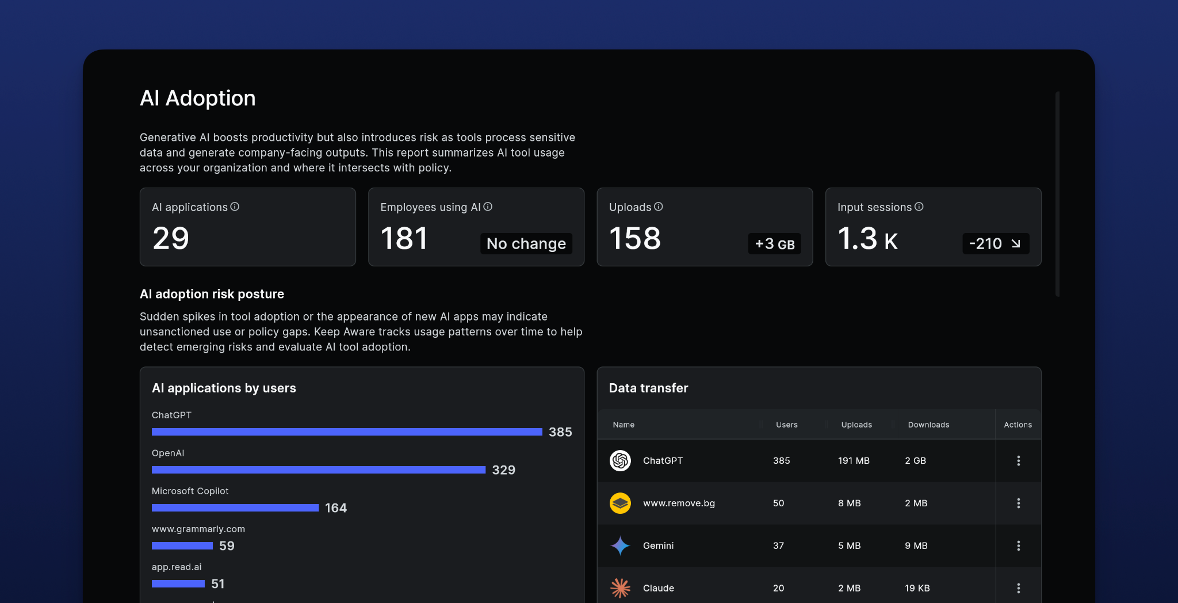

Delete this slide before use
See how Keep Aware secures the browser
https://keepaware.com

